Slide 1

FP&M SETA Presentation – January 2016

Slide 2
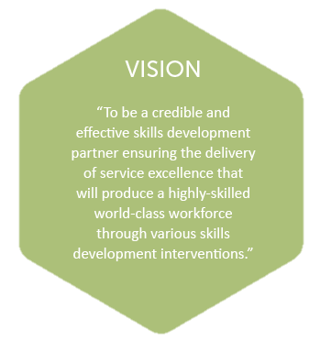
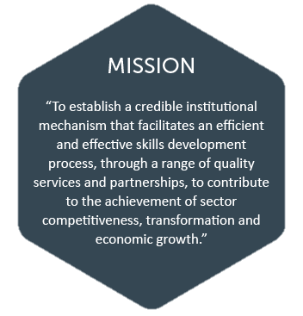
Vision & Mission

Slide 3

Introduction
The Fibre Processing and Manufacturing (FP&M) SETA was established by the Honourable Minister of Higher Education & Training on 1 April 2011 to:
Strengthen
Implement
Support
Value-chain linkages between related industries
Sector initiatives aimed at growth, sustainability & competitiveness
NSDS III in FP&M Sector
Notes:
The assumption is that the audience know what SETAs are:
Facilitation and Quality Assurance of skills development in specific economic sectors eg: FP&M sector
Administration of skills development levies received from member firms via SARS
Distribution of mandatory and discretionary grant funding
Driving force of NSDS III
The assumption is that the audience know what NSDS III entails:
National Skills Development Strategy
Owned by Dept of Higher Education and Training
Focus is on:
Strengthening skills development system include SETAs, TVETs, HETs and other providers.
Sector Skills Planning
Access to learning programmes incl learnerships, apprenticeships – emphasis on PIVOTAL programmes.
Partnerships between employers and FETs/ HETs
Adult Education for young people due to low numeracy and literacy
Workplace skills planning & career pathing framework
Small companies, community organisations, unions
Career Guidance

Slide 4
Introduction
Establishment of FP&M SETA was the result of amalgamation of -
  CTFL SETA (Clothing, Textiles, Footwear, Leather and General Goods);
  FIETA (Forestry, Furniture and Pulp and Paper and Wood Products); and
  Sectors of MAPPP-SETA (Print Media, Printing, Packaging and Publishing)
Step towards alignment with Government’s IPAP2 & New Economic Growth Path to consolidate human resources for manufacturing
Acknowledgement of value chain linkages between the industries represented in the fibre processing and manufacturing sector
Notes:
CTFL = Clothing, Textiles, Footwear, Leather and General Goods sectors
FIETA = Forestry, Furniture, Pulp & Paper and Wood products

Slide 5

Scope of the FP&M SETA
Clothing
Footwear
Forestry
Furniture
General Goods
Leather
Packaging
Print Media
Printing
Publishing
Pulp And Paper
Textiles
Wood Products

Slide 6

Business Challenges
Poor Quality of Work – Errors in Operations
Staff Capabilities Challenge
Poor Performance
Challenges experienced as a result of the amalgamation included -
Huge Customer/ Stakeholder Dissatisfaction
Material Audit Findings

Slide 7


Business Challenges
Complex Policies & Tedious Processes
Causes of the challenges:
Consecutive Audit Qualifications
Poor quality of work, entangled in errors
Lack of Integrated MIS
High Stress in employees – Inefficient use of human resources
SETA’s accreditation/ licensing not renewed
Mediocre Judgment
during Amalgamation
Organisational Design (individuals and not businesses)
Potential Risks:
Demoralised Customers & Stakeholders

Slide 8

New Business Model
During 2013/14, a new Business Model was developed by the CEO in consultation with the FP&M SETA Board and industry stakeholders
Strategic goal underpinning the new Business Model -
  High performing organisation with an effective institutional capacity delivering on innovation, efficiencies, improved productivity and ameliorated financial management with an eye for cost reduction, efficient business model and credible processes
Implement
turn-around strategies to increase efficiencies
Increase performance - in addressing the
critical and scarce skills
Address the Challenges

Slide 9
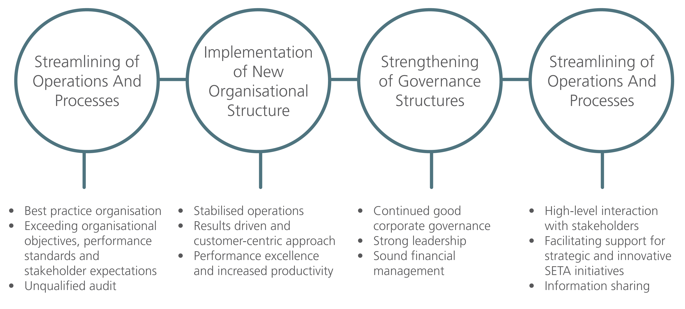
New Business Model
The New Business Model was implemented with effect from April 2014 and Key Focus Strategies included -
Notes:
Prudent financial management resulting in elimination of waste and reduced cost
Implementation of new organisation structure included strategic staff appointments which stablised operations

Slide 10
Mandate
The FP&M SETA is responsible for the implementation of a sector skills development strategy for the FP&M sector as a whole including -
  Provision of skills development services to FP&M sector;
  Promotion and implementation of the objectives of the National Skills Development Strategy (NSDS III); and
  Ensuring that people (employed or wanting to be employed in the sector) obtain the critical or scarce skills that are needed to build the capacity of the sector to become economically sustainable and globally competitive.

Slide 11
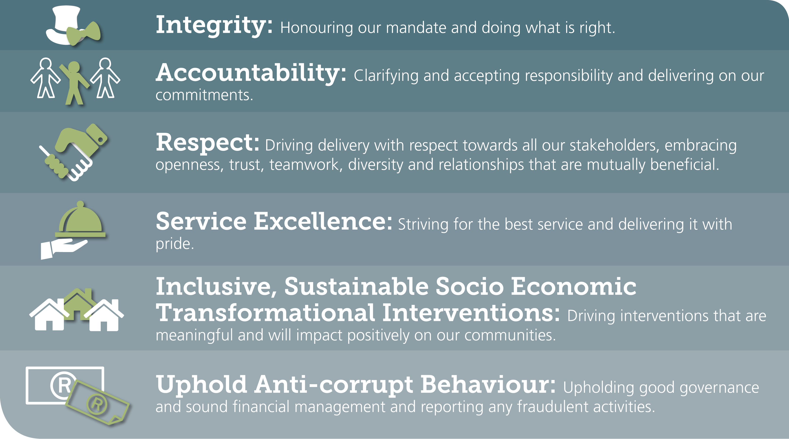
Organisational Values
Definition of VALUES:
Principles or standards of behaviour;
(an organisation’s) judgment of what is important in life.

Slide 12
Financial Performance
Notes:
Income in 2014/15 increased by 13% in comparison to 2013/14

Slide 13
Financial Performance
Notes:
For the 2014/15 financial year, administration income was contained within the 10,5% threshold
Discretionary grant expenditure increased by 145% from the previous year (724% since inception)
Mandatory grant expenditure increased from the previous year due to reversal of a prior year provision and the payment of outstanding grants of R10 million to the relevant employer.
The decrease in expenditure in mandatory grants from 2012/13 to 2013/14 is due to the new grant regulations (from 50% down to 20%)

Slide 14
Performance Trends
Notes:
76% increase in performance since 2011/12

Slide 15
Performance Trends
Notes:
76% increase in performance since 2011/12

Slide 16
Performance Trends
Notes:
Learner registrations increased by 224% since 2011/12. This can mostly be attributed to the increase in discretionary grant expenditure as a result of the new discretionary grant disbursement strategy and efficient project management. The graph also demonstrates increased participation by industry in skills development initiatives.

Slide 17
Performance Trends
Since Inception of the FP&M SETA in 2011
Total number of
learners entered:
26,403 Learners
Total number of learners certificated:
12,122 Learners

Slide 18
Equity & Transformation
Notes:
Notable trends
Black – more than 95% over most categories except artisans (84%)
Women – more than 50% over most categories (except artisans 18%)
Youth – high percentage of unemployed beneficiaries, only 52% of employed beneficiaries, AET only 40%
Need to focus on incorporating people with disabilities in the workplace particularly technical learning areas (artisan trades).
Need to focus on inclusion of women in technical learning areas (artisan trades)

Slide 19


Flagship Project – Fashion Design
Objectives of the project were -
  to provide training to young and upcoming designers and entrepreneurs and inform them about career opportunities in the fashion industry
  to recognise the talents of 20 promising fashion designers in South Africa
  to recognise SA fashion role models
Key components of the project were:
  Enterprise Exhibition
  Information Seminars and Workshops
  Young Fashion Designer Awards
  African Pride Awards.
Funded
R3 million

Slide 20

Flagship Project – Qualifications
Development
  Approximately eight (8) qualifications were submitted to QCTO for registration, which include:
  Upholsterer,
  Sewing Machine Operator,
  Home Textiles Machine Operator,
  Footwear Bottom Stock Production Machine Operator,
  Sheetfed Offset Lithographic Technician
  Silviculture Mobile Plant Operator.

Slide 21



Flagship Project – Richmond-
Indaleni Skills Centre
Offer post-school education and training interventions
Objectives for the establishment of the centre
FP&M SETA Board allocated in excess of R25 million towards the establishment of the “Richmond-Indaleni” Community Skills Centre.
380 unemployed youth from the area
R10,5 million of the total value of the project will be spent on training interventions
Enable young people to develop occupationally directed skills
Contribute to the
socio-economic upliftment
Launched on 7 April 2015
Honourable Minister of Higher Education and Training,
Dr Blade Nzimande

Slide 22
Flagship Project – SAGDA Internship
Partnership
The partnership provided opportunities to 350 learners in
the 2013/2014 and to 210 learners during 2014/2015 financial year of which most have completed the programme and were able to gain permanent positions. Funding allocated during 2014/15 totalled approximately R7,8 million
  place interns within our regional offices and other workplace
FP&M SETA partnered with the South African Graduate Development Association (SAGDA) to place interns to:
They were able to cope with the professional environment due to receiving this work experience opportunity.
work closely with their mentors in order to gain professional exposure

Slide 23

Flagship Project – Clothing SMME
Training in KZN & Western Cape
  40 KZN based SMMEs (mainly in rural areas, including Ladysmith, Isithebe and Port Shepstone)
To date, 1,079 employed and unemployed learners have been registered on management
development programmes, clothing learnerships and skills programmes, broadening the
skills base of workers in the clothing industry and providing opportunities to unemployed
youth to enter the labour market with employable skills.
The Apparel Manufacturers of South Africa (AMSA) Cluster Training SMME Project in KwaZulu-Natal and the Western Cape entailed the development of:
  world class manufacturing
  technical skills development
The project is valued at approximately
R12,3 million
and training is focused on three key areas:
The objective of the project is to improve the SMMEs’
current capability ensuring long term sustainability.
  50 companies in the Cape Metro and rural areas
  such as Atlantis, Caledon and Hermanus
  management development

Slide 24
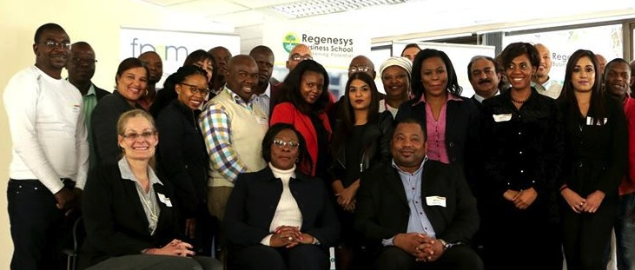
Flagship Project – International
Leadership Development Programme
The ILDP programme provide cutting-edge
knowledge, best practices and trends in
leadership, innovation and entrepreneurship,
by visiting influential institutions and engaging
established leaders in the USA and SA.
The FP&M SETA International Leadership Development Programme (ILDP) is a high level skills programme pitched at NQF level 7/8, designed to provide opportunities to previously disadvantaged individuals to acquire business leadership skills and to address transformation in the sector.
This programme will provide the sector with potential leaders that have a grasp of the technical side of the business as well as the business side.
A budget of
R8,1 million has been set aside
for this project
  Leather and footwear technologists, fashion designers/ technologists/cut-make & trim (CMT), publishers, journalists, foresters, furniture designers, printers, packaging, designers, etc.
Candidates were drawn from the following categories:

Slide 25
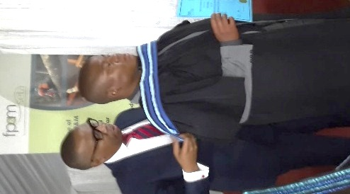
Flagship Project – Ndimase Trading
Disability Project
During 2014, Ndimase Trading trained approximately 600 learners who attended special schools (for mentally and physically disabled learners) as well as unemployed youth in several provinces: Gauteng, KwaZulu-Natal, Eastern Cape, Mpumalanga, Limpopo and North West.
Skills programmes included furniture making (woodwork and upholstery), garment making, general goods manufacturing (belts), footwear (sandals) and screen printing.
The training interventions were recognized and supported by the Department of Education.

Slide 26
QCTO Update
LEGACY QUALIFICATIONS LIFE-SPAN.
  All registered legacy qualifications’ life span is coming to an end on 30 June 2018 (Registration End Date).
  QCTO to advise on the last date for the enrolment of the learners.
  The QCTO only accepted applications for the development / review /
  re-curriculation of qualifications that will replace the existing SETA
  qualifications from 1 Jan 2013 – 31 March 2014.
  The QCTO introduced a moratorium on qualifications development applications for period of six months, from 1 April 2014 to 30 September 2014.
  This moratorium was since lifted and QCTO has been accepting applications
  for registration of new occupational qualifications.

Slide 27
QCTO Update
SOME FACTS TO BE CONSIDERED UNDER THE NEW QUALIFICATIONS LANDSCAPE.
  Training providers will be required to re-apply for accreditation in terms of newly developed QCTO qualifications.
  Legacy qualifications will become redundant.
  Grants will be approved based on the new QCTO model.
  Funding will be directed through the Quality Development Partners (QDPs) and the Assessment Quality Partners (AQPs).
  All the certificates, including the trades, will be printed by the QCTO

Slide 28
QCTO Update
ASSISTANCE AVAILABLE FROM THE FP&M SETA
  The FP&M SETA has a dedicated QA (Quality Assurance) Division that is responsible for the coordination of occupational qualifications development and implementation in the FP&M Sector.
  Mr. Johnny Modiba (Qualifications Development Manager) is responsible for all QCTO related functions. He is available to assist with information pertaining to the development of occupational qualifications, assessments, SLAs, annexures to the SLAs, etc. He also coordinates DQP (Development Quality Partner) and AQP (Assessment Quality Partner) activities.
  All the FP&M SETA’s Regions have QA Specialists, who assist with processing of related queries.
  The QA Executive Manager is responsible for the interpretation of legislation and alignment to the new landscape, and related legislative prescripts.

Slide 29
Research and Skills Planning
  Establishment of a Research Chair at the School of Education, University of Witwatersrand.
  Funding of 4 full-time PhD students.
  Completion of 6 academic papers focusing on international case studies of key sub-sectors.
  Formation of partnerships and knowledge sharing with Labour Market Intelligence Partnership (LMIP) and Post School Education and Training Research Forum (PSET).
  Submission of the Sector Skills Plan for 2015/16 aligned with DHET criteria and framework.
  Production of research instruments and methodologies for the compilation of the
  OFO Based Scarce & Critical Skills and PIVOTAL Skills List

Slide 30
Research and Skills Planning
The FP&M SETA’s Research Divisions would like to achieve the following:
  Best practice model for the FP&M SETA sub-sectors benchmarked both locally and globally
  Streamlined information flow between the SETA and its 13 sub-sectors
  Enhanced engagements with our stakeholders through planned online surveys and focus groups sessions in 2016.
  Information and knowledge on international best practices related to skills development.
  Continued contribution to skills planning and skills development research research
  Continued support of Masters and PhD students

Slide 31
Stakeholder Perceptions
2013 vs 2014 Stakeholder Perception Survey Results
TESTED COMPONENT | 2013 | 2014
RESPONDENTS | 59 responses | 124 responses
Customer Relations | Unsure | Agree
Grant Disbursement Application and payment | Unsure | Agree
Quality Assurance | Disagree | Agree
Communication and Stakeholder Engagement | Unsure | Agree
Sectoral Support | Unsure | Agree
Corporate Governance | Unsure | Neutral bordering improvement
Notes:
The FP&M SETA stakeholder perception survey conducted during the financial year shows a significant shift of perception among the stakeholders between 2013 and 2014 calendar years. This is indicative of the impact that the customer-centric business model has had on stakeholders’ experience with regards to the SETA, demonstrating a significant increase of business confidence among our stakeholders in the sector.

Slide 32
Forward Looking Plan
Strategic Partnerships
Mandatory Grant Opportunities – Funding Window now open – closes on 30 April 2016
  Information exchange on scarce & critical skills
  Funding for training of employees and unemployed learners
Discretionary Grant Opportunities – Funding Window now open – closes on 30 April 2016
  Funding to address skills priorities at company, sub-sector, sector and national level
Strategic Sector and National Priorities that require effort from Industry
  Apprenticeship and learnership registrations and completions (need for artisan development)
  WIL Placement of learners and graduates from HEIs and TVETs
  Close-out of current projects funded by FP&M SETA
    Reporting on completions of all learning programmes
  Strategic partnerships to address sectoral and national skills development

Slide 33
Contact Details
REGIONAL OFFICES
Johannesburg
  William Malema – 011-403 1700
  WilliamM@fpmseta.org.za
Cape Town
  Leigh Hayes– 021-462 0057
  LeighH@fpmseta.org.za
Durban
  Lungile Shabangu– 031-7024482
  LungileS@fpmseta.org.za
HEAD OFFICE
Skills Planning & Reporting
  Elmine Baumann – 031-7024482
  ElmineB@fpmseta.org.za
Learning Programmes
  Sylvia Tsunke– 011-403 1700
  SylviaT@fpmseta.org.za
Quality Assurance
  Johnny Modiba– 011 – 403 1700
  JohnnyM@fpmseta.org.za
Monitoring & Evaluation
  Linda Mngadi – 011-403 1700
  LindaM@fpmseta.org.za

Slide 34
Thank you

